Slide 3
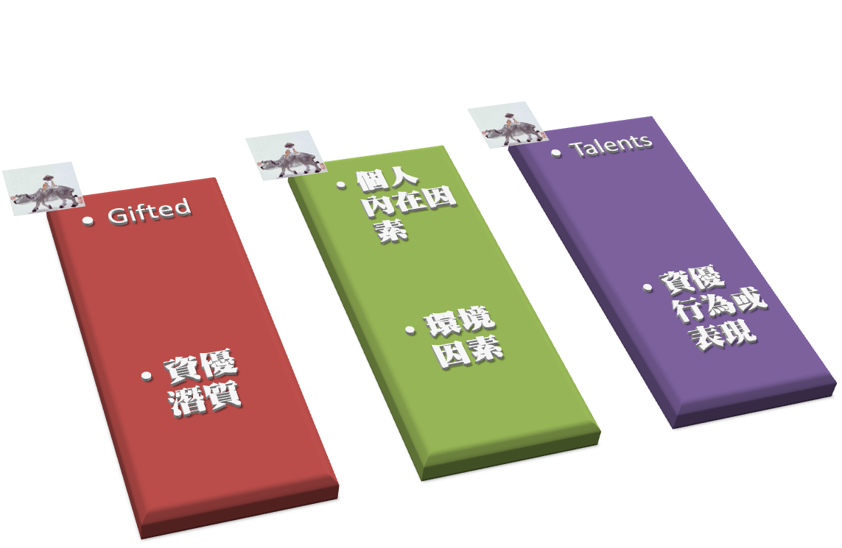

Slide 4
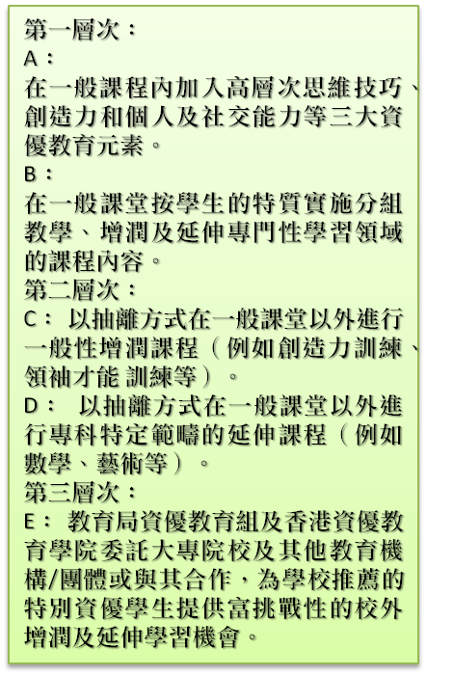

Slide 10
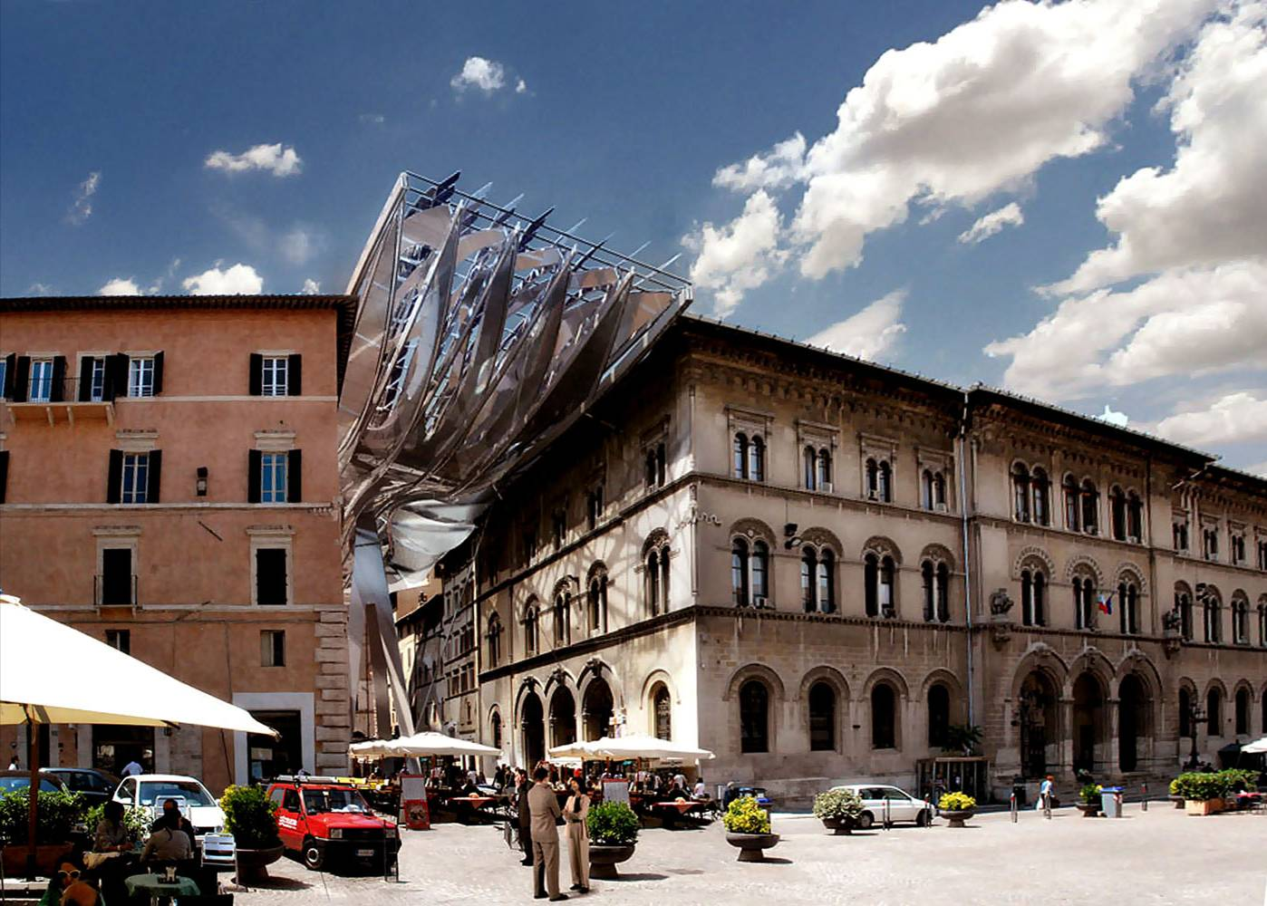
Energy Roof (design), Perugia, 2010 (Coop Himmelblau, Austrian architects)

Slide 11
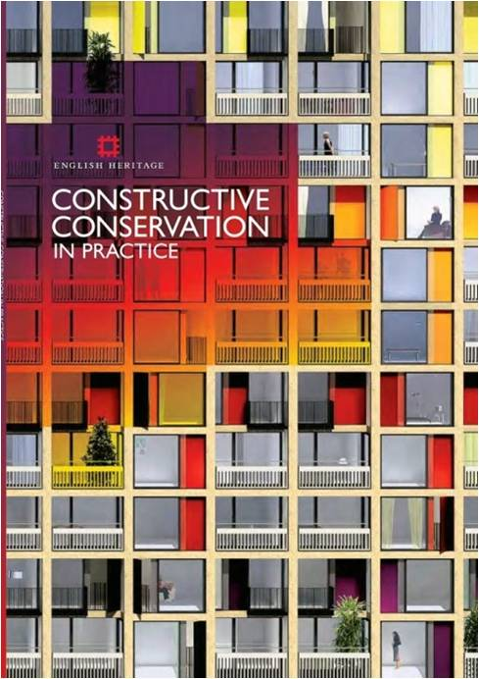

Slide 13
