Slide 1







Quality Education Fund Thematic Network (QTN)
on Promoting Wellness in School
優質教育基金
《共建卓悅校園》
主題網絡計劃
Faculty of Social Sciences
HKJC Centre for Suicide Research and Prevention
The University of Hong Kong
June 2, 2021
總結
分享會
Dissemination Seminar

Slide 2

Today's Agenda
第一部份
3:00 – 3:15 | 致送紀念品及合照 優質教育基金代表
3:15 – 3:45 | 歡迎辭 及 主題網絡計劃簡介 香港大學香港賽馬會防止自殺研究中心 總監葉兆輝教授 及 中心代表
3:45 – 4:00 | 小休 參觀優質教育基金計劃成品 幼稚園、小學、中學教職員移步到不同講堂
第二部份
4:00 – 4:45 | 幼稚園、小學、中學分組進行經驗分享及討論

Slide 3
Quality Education Fund Thematic Network (QTN)
on Promoting Wellness in School
優質教育基金
《共建卓悅校園》
主題網絡計劃
Faculty of Social Sciences
HKJC Centre for Suicide Research and Prevention
The University of Hong Kong
June 2, 2021
致送
紀念品
及合照

Slide 4

Quality Education Fund Thematic Network (QTN)
on Promoting Wellness in School
優質教育基金
《共建卓悅校園》
主題網絡計劃
Faculty of Social Sciences
HKJC Centre for Suicide Research and Prevention
The University of Hong Kong
June 2, 2021
歡迎辭及 計劃簡介
葉兆輝教授

Slide 5
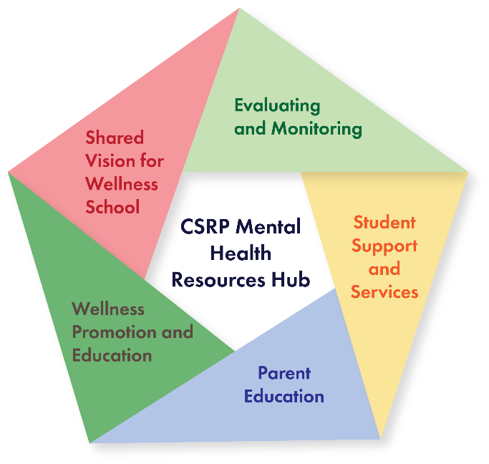
關於我們
A Knowledge and Impact Hub
Research
Knowledge
Impact

Slide 6












Prof Paul Yip
Director
Dr Anna Wong
Ms Anna Chan
Postdoctoral Fellow
Training Consultant /
Counselling Psychologist
Team Members
Ms Alyse Hung
CSPR
QTN
Dr Iris Chan
School Development Officer
(Secondary School)
Project Officer
Ms Trista Kuan
School Development Officer
(Primary School)
Ms Wing Wong
School Development Officer
(Kindergarten)
我們的團隊

Slide 7






《共建卓悅校園》計劃發展過程及概要
2014
2015-2019
2019-迄今
香港大學香港賽馬會防止自殺研究中心自2002年成立以來，一直關注公眾，尤其兒童及青少年的精神健康。
2014年，本中心承蒙「優質教育基金」 委託，對其資助有關培養學生正面態度和價值觀的計劃項目作探討工作，並將研究成果及經驗分享，輯錄於《培養學生正面態度和價值觀資源冊》。
2015年4月至2019年8月，「優質教育基金」資助下，我們開展《培養學生正面態度和價值觀》 主題網絡計劃，發展一套循證為本的課程, 促進中、小學生的精神健康。
計劃採用「公共衛生」模型策略，以及「生理-心理-社會」架構，作為課程及活動的框架。
承蒙「優質教育基金」的持續支持，我們於2019年9月開展新一階段的主題網絡計劃—《共建卓悦校園》。建基於中、小學的成功經驗，計劃順利將計劃活動推展至幼稚園。
旨在將精神健康教育融入學校課程，培養和增強學童抵抗逆境的韌力，並讓學校轉化為以學生「幸福感為先」的校園。

Slide 8

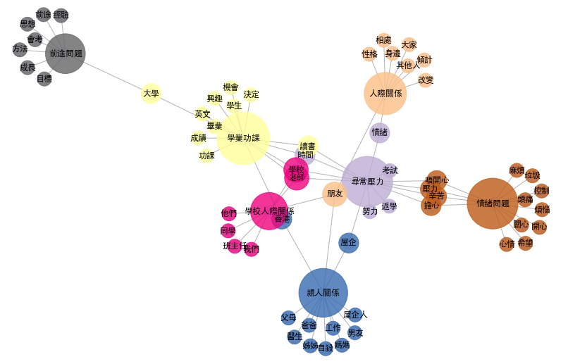
DSE學生的求助電話內容主題及關
以Latent Dirichelet Allocation（LDA）主題模型演算，分析了解 DSE學生求助者與輔導員在電話傾談中的內容
根據分析，以下是DSE學生求助者(Help seekers)
在電話傾談中的主導話題：
1：一般壓力（包括考試、屋企、情緒、學校）
2：人際關係
3：家庭關係
4：學校人際關係
5：親人關係
6：學業功課
7：前途與未來
在不同的DSE學生求助電話傾談中，「朋友」、 「學校」、「老師」經常被提及；可見三者對這類求助者的重要性。
Update this from Oct 2018 to May 31 2020??

Slide 9


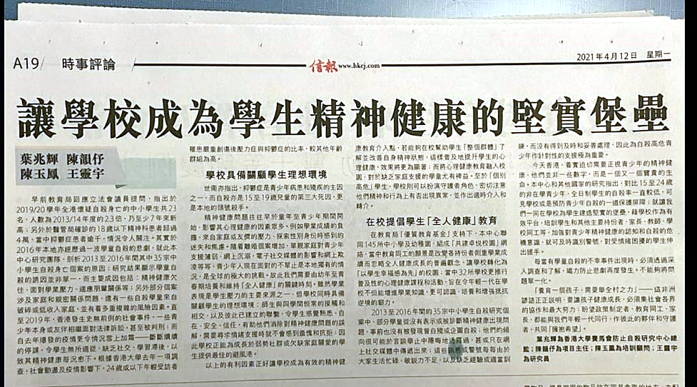


讓學校成為學生精神健康的堅實堡壘
“ … 學校同時俱備關顧學生的理想環境:
師生與同學間恆常的接觸和相交，以及彼此已建立的聯繫，令學生感覺熟悉、自在、安全、信任，有助他們消除對精神健康問題的誤解，需要尋求情緒支援時就不會感到羞愧和抗拒；因此學校正能為成長於弱勢社群或欠缺家庭關愛的學生提供最佳的避風港。”
“在教育局【優質教育基金】支持下，本中心聯同125所中小學及幼稚園， 組成「共建卓悅校園」網絡，當中教育同工的願景是改變各持份者側重學業成續而忽略全人健康成長的普遍觀念，讓學校轉化為「以學生幸福感為先」的校園; 當中32所學校更推行普及性的心理健康課程和活動，旨在令年輕一代在學校不但能增進學業知識，更可認識、培養和增強抵抗逆境的韌力。”

Slide 10

《培養學生正面態度和價值觀》計劃的成果
（過往QTN計劃的（2015-2019）得著與反思）
What we have achieved in the previous phase (2015-2019)
學校更重視學生的精神健康
老師對正向教育內容及應用更了解
學生更懂得感謝和諒解父母、同儕、老師
學生更具同理心，擁有更好的同儕關係
更好的師生關係(尤其在小學階段)
據老師表示，大多數學生參與QTN計劃後，「情意及社交表現評估」(APASO)顯示更多正面的結果。
Schools show more concern on the mental wellbeing of students
School teachers gained more understanding on the elements of Positive Education and how it can be applied in the schools
Students have become more thankful to their parents, peers and teachers and more empathetic
Students are more empathetic and have better peer relationships
Better teacher-student and teacher-teacher relationships, especially in primary schools
According to teachers, most students showed more positive results on APASO after joining QTN
However,
There are still difficulties encountered
  Over packed curriculum and heavy workload and stress of teachers
  Most schools are still academically oriented
  Teachers are lack of self-efficacy in teaching and administrative support

Slide 11







《培養學生正面態度和價值觀》的困難和建議
（過往QTN計劃的（2015-2019）得著與反思）
困難
建議
學校的
投入程度
以學業成績
為導向
教師
工作量大
「全校性 」的精神健康教育方針
(Whole-school approach)
提升教師的能力和「自我效能感」
(self-efficacy)
促使學校作好準備推廣精神健康教育，並以學生精神健康為重。
將精神健康教育融合於各個學習領域
建立學生精神健康教育實踐指南
校長和管理層教職員給予的行政支持
CSRP作為
精神健康
資源中心
對精神健康
關注不足
有限的
教學時間
過度緊迫的課程
教授精神
健康的課題
信心不足
對計劃評估
的重要性
了解有限
缺乏
行政支援

Slide 12

《共建卓悦校園》計劃的展望(2019-2024)
Stage III
Stage II
建立一個「精神健康資源中心」
提供一站式的精神健康教育服務
在社區和個人層面上提供諮詢和其他支援
Stage I
共同建立「促進精神健康」的願景
分享傳遞良好實務範例
邀請更多幼兒園，作為“夥伴” 和“網絡”合作單位
擴展計劃至幼兒園
加強家長教育和教師培訓
繼續實行現有不同級別、普遍性和選擇性的課程
研究及發展「幸福感為先校園」實務指南

Slide 13
Quality Education Fund Thematic Network (QTN)
on Promoting Wellness in School
優質教育基金
《共建卓悅校園》
主題網絡計劃
Faculty of Social Sciences
HKJC Centre for Suicide Research and Prevention
The University of Hong Kong
June 2, 2021
計劃評估
Programme Evaluation
Dr Anna Wong

Slide 14
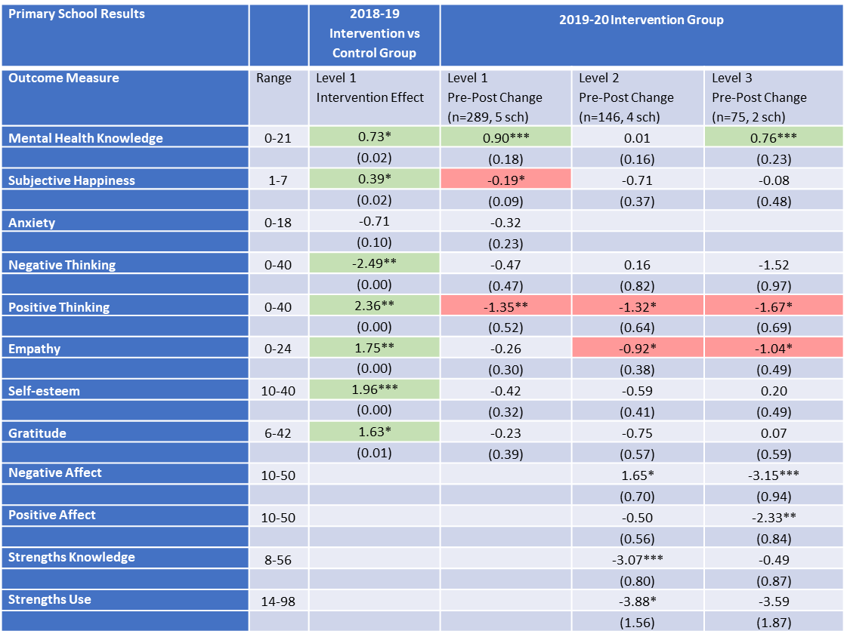
Report from 2018/19-2019/20: Pre- & Post-Test Survey
Primary School Results Overview:
Generally more negative curriculum and wellbeing outcomes than 2018-19
Larger environment affected children’s wellbeing
No “intervention vs control effect” available due to lack of control group for comparison
Notes:
Larger environment: Learn from Home may be a negative experience for primary school students (more than secondary)

Slide 15
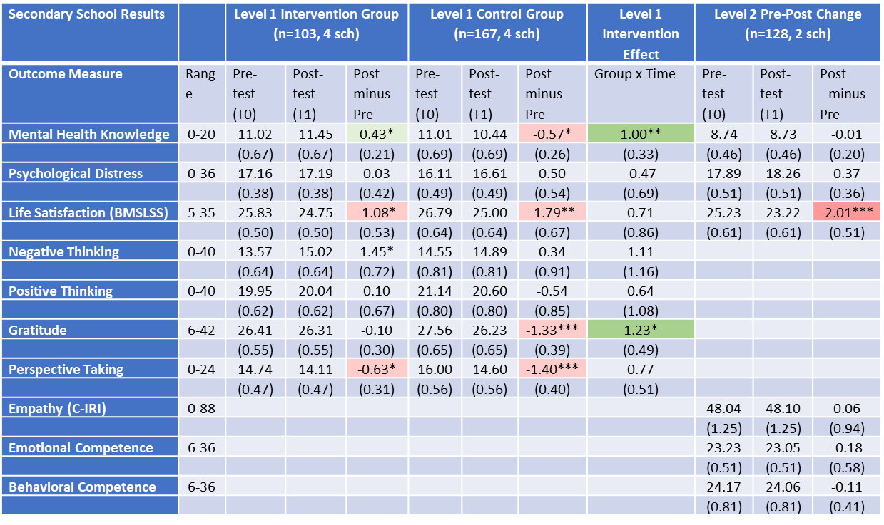
Report from 2018/19-2019/20: Pre- & Post-Test Survey
Secondary School Results Overview:
Level 1 intervention effects were positive & significant in mental health knowledge and gratitude
Level 2 students showed significant decrease in Life Satisfaction
At Level 2, no “intervention vs control effect” available due to lack of control group for comparison
Notes:
Knowledge → Attitude → Behaviour
How to progress to the next stage?

Slide 16
Primary School 2020/21: Results Overview
Primary School Student Wellbeing (1 School, P4-6, n=157, Sept-Feb)
*P < .05, **P < .01, ***P <.001
Notes:
Wellbeing (1 school, n=157, start to mid-year)
Self-rated sleep problem worsened overall (p=.03*)
Increased in P.6 students (p=.01**), P.4,5 n.s.
Increased in Girls (p=.00***), Boys n.s.
School connectedness improved overall (p=.00**)
Boys’ connection with adults improved (p=.01*), Girls n.s.
P.4 students’ connection with adults improved (p=.01*), P.5,6 n.s.
P.4 students’ negative connectedness decreased (p=.00***), P.5,6 n.s.
Learning motivation
Less intrinsic in Boys (p=.02*), Girls n.s.
Less intrinsic in P.5 students (p=.03*), P.4,6 n.s.
Bullying behaviour decreased overall (p=.01**)
Decreased in Boys (p=.00***), Girls n.s.
Decreased in P.4 (p=.04*), P.5 (p=03*), P.6 n.s.
Frequency of being bullied
Decreased in Girls (p=.03*), Boys n.s.
Decreased in P.4 (p=.03*), P.5,6 n.s.

Slide 17
Primary School 2020/21: Results Overview
Primary School Curriculum Level 1 (n=54)
  Mental health knowledge increased overall (p=.04*)
Primary School Curriculum Level 2 (n=52)
  Mental health knowledge increased overall (p=.03*)
*P < .05, **P < .01, ***P <.001

Slide 18
Primary School 2020/21: Results Overview
Significant findings on primary school student outcomes
(1 school, n=157, start to mid-year)
Sleep problem
School connectedness: “Connection with adults” and “Negative connectedness”
Bullying behaviour and frequency of being bullied
Girls and P.6 wellbeing change more negative
Boys and P.4, P.5 wellbeing change more positive
Mental health knowledge increased significantly
Notes:
Self-rated sleep problem worsened overall (p=.03*) especially in Girls and P.6
Connection with adults and negative connectedness improved overall (p=.00**) especially in boys and P.4
Bullying behaviour decreased overall (p=.01**) esp. in Boys, P.4, P.5
Frequency of being bullied decreased in Girls and P.4
Learning motivation became less intrinsic in boys and P.5

Slide 19
Secondary School 2020/21: Results Overview
Secondary School Student Wellbeing (4 schools, F.1-2 & F.4, n=263)
*P < .05, **P < .01, ***P <.001
Notes:
Knowledge → Attitude → Behaviour
How to progress to the next stage?
Wellbeing (4 school, n=263)
Self-rated health worsened overall (p=.02*)
Worsened in Girls (p=.01**), Boys n.s.
Worsened in F.1 (p=.00**), F.2,4 n.s.
Sleep problem
Increased in Girls (p=.03*), Boys n.s.
Psychological distress
Worsened in F.4 (p=.03*), F.1,2 n.s.
Self-compassion
Self-criticism increased in Girls (p=.03*), Boys n.s.
Self-compassion improved in F.1 (p=.03*), F.2,4 n.s.
Resilience
Decreased in Girls (p=.01*), Boys n.s.
Learning motivation
Boys’ intrinsic motivation increased (p=.03*), Girls n.s.
Bullying behaviour decreased overall (p=.01*)
Decreased in Boys (p=.05*), girls n.s.

Slide 20
Secondary School 2020/21: Results Overview
Curriculum Level 1 (4 Schools, N=278), Level 2 (2 Schools, N=125)
  Level 1 Mental health knowledge increased in Girls (p=.00***)
  Level 2 Mental health knowledge increased overall (p=.03*), esp. F.3 (p=,04*)
Notes:
Level 1: Compassion increased in F.2 (p=.04*), F.1,4 n.s.
Level 2: Empathy decreased in F.2 (LWL) (p=.03*), F.3 n.s.

Slide 21
Secondary School 2020/21: Results Overview
Significant findings on secondary school student outcomes
(4 school, n=263)
Physical health: Self-rated poor health and Sleep problem
Psychological distress
Coping: Self-compassion and Resilience
Bullying behaviour
Learning motivation
Girls wellbeing change more negative
Boys wellbeing change more positive
Mental health knowledge increased significantly (at Level 1, Girls only)
Notes:
Significant findings on secondary school student outcomes
(4 school, n=263)
Self-rated health worsened overall (p=.02*), esp. in Girls and F.1
Sleep problem increased in Girls
Psychological distress worsened in F.4
Self-compassion worsened in Girls (Self-criticism) and improved in F.1 (SC)
Resilience decreased in Girls
Bullying behaviour decreased overall (p=.01*) esp in Boys
Learning motivation became more intrinsic in Boys
Mental health knowledge increased significantly in girls

Slide 22

Benefits of Our Evaluation
Built on scientific theory and evidence
Monitor systematically student wellbeing
Can see progress:
Conduct analysis to identify areas for reinforcement or improvement
  Individual Annual Report summarizing the overview of students wellbeing & curriculum outcome will be generated for every participating school
  Every participating school will be informed of its unique situation to facilitate reinforcement and improvement in promoting student wellbeing
Knowledge
Attitude
Behaviour
Notes:
Monitoring student wellbeing
Understanding students’ wellbeing patterns
Which groups / individuals are at risk
Knowledge → Attitude → Behaviour? How to progress to the next stage?
Evidence-based good practices
Knowledge exchange
Analysis and feedback on Program
Training
Teacher development
Program implementation

Slide 23
Quality Education Fund Thematic Network (QTN)
on Promoting Wellness in School
優質教育基金
《共建卓悅校園》
主題網絡計劃
Faculty of Social Sciences
Centre for Suicide Research and Prevention
The University of Hong Kong
June 2, 2021
研究成果Research Outcomes

Slide 24
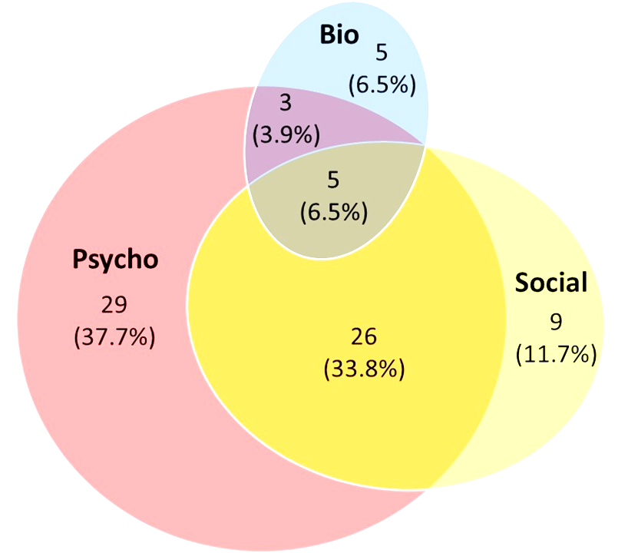
Research Outcomes
“The use of bio-psycho-social model in school-based mental health promotion”
Submitted to Frontiers in Psychiatry (In review)

Slide 25
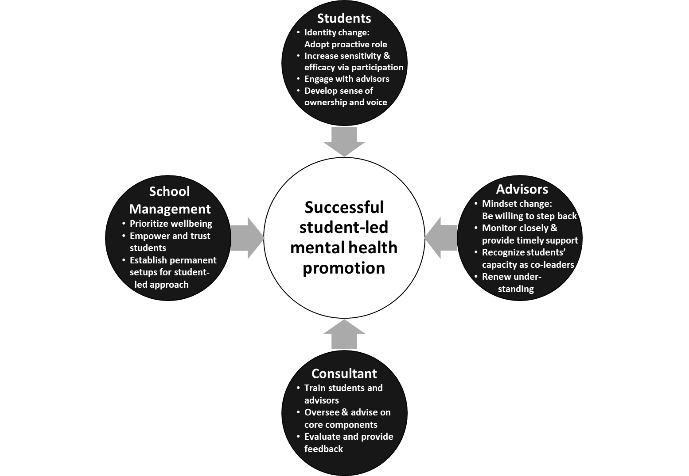
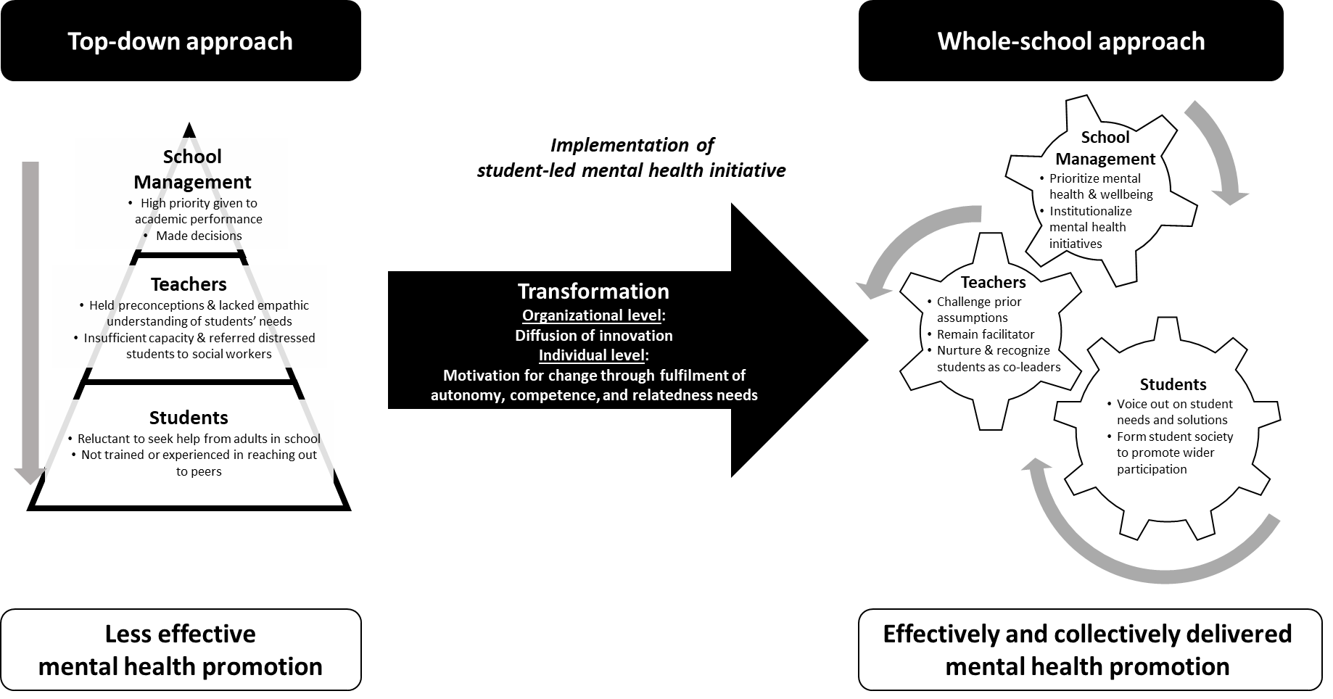
Research Outcomes
“Diffusing innovation and motivating change in school:
A case study on student-led intervention turned whole-school approach to mental health promotion”
Submitted to Journal of School Health

Slide 26
Quality Education Fund Thematic Network (QTN)
on Promoting Wellness in School
優質教育基金
《共建卓悅校園》
主題網絡計劃
Faculty of Social Sciences
HKJC Centre for Suicide Research and Prevention
The University of Hong Kong
June 2, 2021
計劃概念
Conceptual Framework

Slide 27
Public health approach to wellbeing promotion and education
We design and conduct interventions appropriate to the level of need/risk:
Indicated
Identified students
Students identified with
mental disorders
Multi-level approach
Tip of the iceberg
Selective
Subgroups with high risk
Students at risk of mental disorders, emotional or
behavioral problems
Using a universal preventive approach can help reduce the number of students escalating to higher levels of mental health needs and suicide risk
Universal
The entire population
All students
regardless of risk level
Source: WHO. (2010)

Slide 28

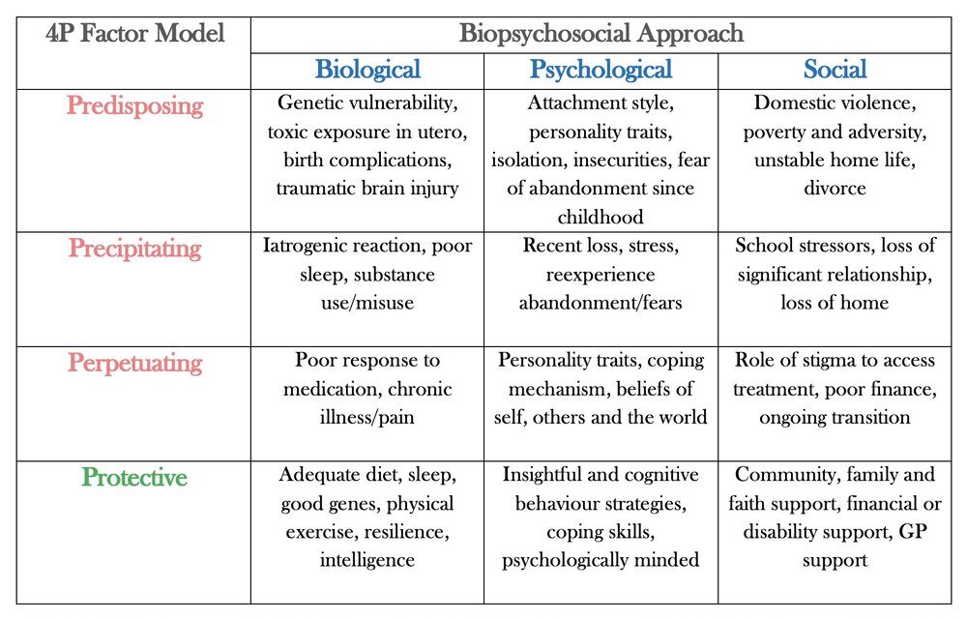
Bio-Psycho-Social Approach to Mental Health
We target Physical health, psychological wellbeing, and social connectedness, the wellbeing goals in 3 domains (B-P-S)
“B-P-S” is a holistic approach to mental health examining multiple factors that affect the whole person (Engel 1977)
All 3 are necessary for children and youth to experience mental health and wellbeing
These factors interact with one another, leading to mental health outcomes
E.g. Sleep problem (sleeping habit, food and drink, stress, worrying thoughts, deadlines, access to healthcare)
Resource: Andreas Astier’s “The 4P Factor Model and Its Purpose in Psychological Medicine”

Slide 29
Bio-Psycho-Social Approach to Mental Health
We adopt the BPS approach to support students to achieve B-P-S goals in their daily lives, resulting in better mental health and wellbeing
(Step 1) Identify relevant factors and objective in each domain for school students
(Step 2) Understand how factors interact to achieve (vs. undermine) B-P-S goals (Physical health, psychological wellbeing, social connectedness)
(Step 3) Explore how the objectives can be achieved in school (e.g. wellbeing curriculum, positive learning environment, therapeutic activities)
Resource: Andreas Astier’s “The 4P Factor Model and Its Purpose in Psychological Medicine”

Slide 30

The four levels in QTN Project 《共建卓悅校園》
“Transformation of all participating schools into wellbeing first schools”
CSRP (HKU)
Secondary
(57 sch)
Core* (3)
Partner (9)
Primary
(63 Sch)
Core* (3)
Level 1: CSRP
Secondary/ Primary/ KG Section
Level 3: School
Level 2: School Network
KG
(5 KG)
Core
(2)
Partner (14)
Network (46)
Network (45)
Level 4: Student
C1
C2
[P1-9]
[N1-45]
C1
C2
[P1-14]
[N1-46]
C1
C2
C3
C3
Partner (1)
P1
Network (2)
[N1,2]
Note: Number of schools in 2020-21

Slide 31
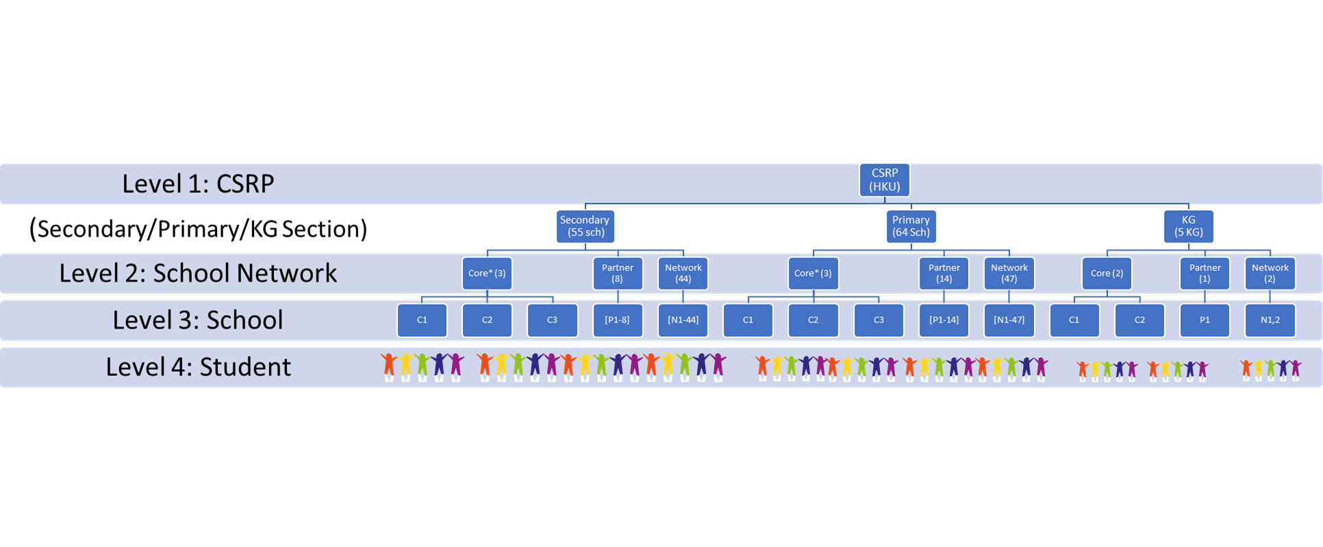
Transformation into Wellbeing First School (WFS) through:
Intervention, Development, Evaluation & Research
Network level:
How can interschool visits facilitate knowledge exchange & sharing of good practices?
Individual School level:
What are key factors that facilitate transformation of schools into WFS? Are the training & support helpful to teachers promoting WFS?
Individual School level:
How can schools best support teachers’ agency & wellbeing?
Student level:
Is the wellbeing curriculum effective?
Do students show better wellbeing, wellness-promoting behaviours, and increasing capacity to promote WFS?

Slide 32
Measurable Outcomes of Wellbeing First School
School Network
School
Student
Formation of a self-sustaining and growing alliance (or Communities of Practice) of Wellbeing First schools
Participating schools function as Wellbeing First Schools (according to WFS principles):
Student population has better mental health/wellbeing, increased wellness-promoting behaviour, and increased capacity to promote wellness in school
Impact
A model of wellness promotion in schools (Wellbeing First Schools) is established and will be sustained by the WFS Alliance to continually improve student mental health and wellbeing
School policy and practice show higher priority and relevance in promoting wellbeing in school
School staff demonstrates better motivation and capacity to implement wellbeing curriculum and promote mental health

Slide 33
Quality Education Fund Thematic Network (QTN)
on Promoting Wellness in School
優質教育基金
《共建卓悅校園》
主題網絡計劃
Faculty of Social Sciences
HKJC Centre for Suicide Research and Prevention
The University of Hong Kong
June 2, 2021
「幸福感為先校園」實務指南
Wellbeing-First School Guidelines

Slide 34
Wellbeing First School Guidelines
We will publish a set of guidelines to support schools to achieve the goals of Wellbeing First School
Guidelines tailored for Secondary, Primary, and Pre-Schools
Evidence-based and relevant to Hong Kong context
Inclusive, considering diverse student characteristics and needs
Contains: Core principles, Case illustrations, Benchmarking indicators & tools
Research and consultation behind the Guidelines development:
Review International Guidelines
Consult Principals
Interview Teachers & Students
Observe & Collect Good Practices from Schools
Advisory Committee Gives Preliminary Feedback
Revise for Publishing in 2022
Notes:
10 Principles
Evidence-based and relevant to HK
Inclusive, considering diverse student characteristics and needs
Informed by interviews with school members + observation of school practices
Benchmarking
Good practices, for KG, for Prim, for Second
Evaluation indicators and tools

Slide 35
Quality Education Fund Thematic Network (QTN)
on Promoting Wellness in School
優質教育基金
《共建卓悅校園》
主題網絡計劃
Faculty of Social Sciences
HKJC Centre for Suicide Research and Prevention
The University of Hong Kong
June 2, 2021
推行方案
Implementation
Plan
Ms Anna Chan

Slide 36
We support teachers to promote and develop values education
Foci of Development of Support Service
To create a shared vision on wellness promotion with participating schools
To promote holistic approach to mental wellness by adopting the biopsychosocial model
To implement a learning curriculum to promote wellbeing in schools
To enhance parent-child relationships and nurture positive parenting
To transfer good practices and knowledge to schools
To establish a Mental Wellness Resource Hub for wellness education for different stakeholders in the community

Slide 37



Mode of Participation
Number of Participating Schools: 125
 | Target of Support | Core* Schools | Partner Schools | Network Schools
Kindergartens | K2, K3 | 2 | 1 | 2
Primary Schools | P4, P5, P6 | 3 | 14 | 46
Secondary Schools | F1, F2, F3 | 3 | 9 | 45

Slide 38


幼稚園課程(KG)
K2 課程目標：認識和培養品格優點
課節 | 教學重點
1.1 熊哥哥的生日 | 人與人之間的親密關係
1.2愛的語言(一) | 愛的語言（身體接觸） 尊重他人
1.3愛的語言(二) | 愛的語言（説話） 以禮待人
1.4愛的語言(三) | 愛的語言（行動） 樂於助人
*O1愛的語言(四) | 愛的語言（禮物） 製作禮物
1.5認識情緒 | 情緒辨識
*O2認識情緒(二) | 情緒表達
1.6情緒調節(一) | 情緒調節（傷心）
1.7情緒調節(二) | 情緒調節（生氣）
1.8情緒回應 | 同理心 愛的語言（陪伴）
*自選後續課程
課節 | 教學重點
2.1 | 蝴蝶結不見了
2.2 | 我的責任(1)
2.3 | 我的責任(2)
2.4 | 化解衝突
*O3 | 團體精神 (1)
*O4 | 團體精神 (2)
*自選後續課程

Slide 39



幼稚園課程(KG)
K3 課程目標：認識和培養品格優點 (發展中)
包含六大品格優點:
1. Honesty (真誠)
2. Bravery (勇敢)
3. Perseverance (堅毅)
4. Zest (熱情與幹勁)
5. Gratitude (感恩)
6. Appreciation of Beauty & Excellence (欣賞美麗與卓越)

Slide 40


小學課程(PRI)
課程目標：認識和培養品格優點和幸福感
初階課程
主題 | 內容
1 | 課程簡介和情緒管理1
2 | 情緒管理2
3 | 認知行為模式1
4 | 認知行為模式2
5 | 解決問題技巧
6 | 社交及溝通技巧
7 | 同理心1
8 | 同理心2
9 | 感恩之心
10 | 總結
中階課程
主題 | 內容
1 | 預備課
2 | 我的優點
3 | 智慧與知識I ─ 愛好學習、好奇心
4 | 智慧與知識II ─創造力
5 | 勇氣 I ─勇敢
6 | 仁愛 I ─ 愛與被愛、仁慈
7 | 節制 I ─審慎
8 | 靈性與超越I ─ 欣賞美麗與卓越、感恩
9 | 總結
高階課程
主題 | 內容
1 | 預備課
2 | 智慧與知識II ─ 判斷力和開明的思想
3 | 勇氣II ─ 堅毅
4 | 仁愛II ─ 社交智慧
5 | 公義 ─ 團隊精神
6 | 節制II ─ 自我約束
7 | 靈性與超越II ─ 希望
8 | 總結

Slide 41
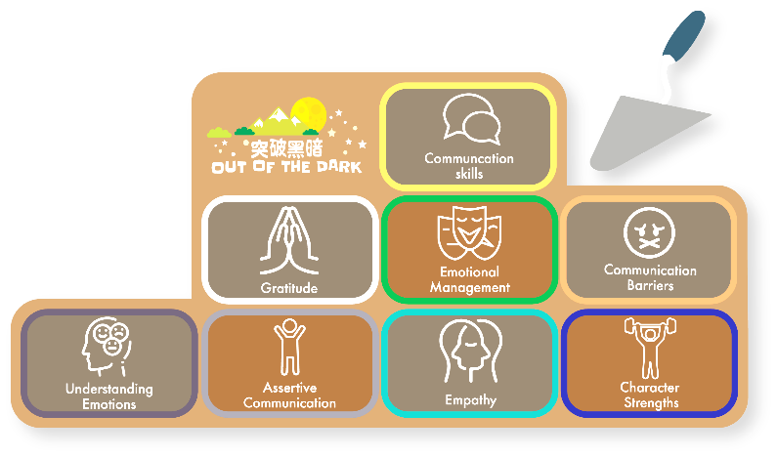

中學課程(SEC)
課程目標：認識有助維持精神健康的因素和培養抗逆力
中一課程
主題 | 內容
1 | 認識情緒
2 | 情緒管理
3 | 認識品格優點
4 | 品格優點 行動篇
5 | 溝通障礙
6 | 果敢表達
7 | 同理心第一步
8 | 同理心 體驗活動
9 | 感恩之心
10 | 重溫及總結
特別課堂1 | 認識精神健康 (E-Learning)
特別課堂2 | 果敢表達 (E-Learning)
中二課程
主題 | 內容
1 | 同理心第二步
2 | 識別和表達自己的情緒
3 | 識別別人的情緒
4 | 明白和體諒他人
5 | 積極聆聽與建立信任
6 | 實踐同理心活動
7 | 處理衝突I
8 | 處理衝突II
9 | 總結
中三課程
主題 | 內容
1 | 同理心第三步
2 | 同理心地圖
3 | 果敢表達
4 | 實踐同理心活動
5 | 學習道歉I
6 | 學習道歉II
7 | 寛恕
8 | 總結

Slide 42
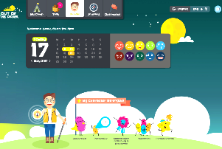

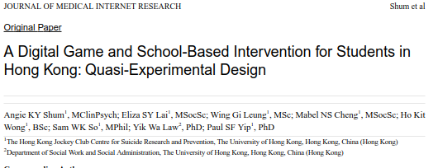
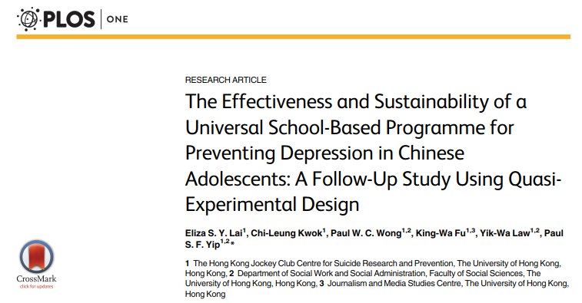
Lesson Structure (~ 40 mins)
School-based + Web-based Programme
Refresh time/ relaxation
Goals and objectives
Warm up activities
Teachers’/students’ sharing
Main activities
Reflection + Mindfulness
Summary
Activities
  Video (movie/cartoon clips, short video)
  Role play
  Group discussion
  Self-reflection

Slide 43
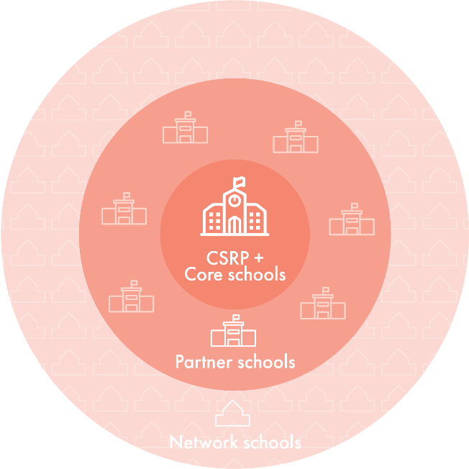
Mode of Exchange and Collaboration
Share the same vision with CSRP on the importance of promoting mental wellness
Implement the multiple-level mental health enhancement program with the support of CSRP
Proactively organize on-site mental health promotion activities with the QEF grant
Actively engage in meetings (including executive committee meeting and other meetings on program development and implementation), evaluation, arrangement of student programs and other professional training, etc.
Have experience in promoting mental wellness in school
Fulfill its role and commitment
Core
Share the same vision with CSRP on the importance of promoting mental wellness
Implement the mental health enhancement program with the support of CSRP
Proactively organize on-site mental health promotion activities with the QEF grant
Are willing to participate in professional training
Are willing to work with core schools
Fulfill its role and commitment
Partner
Are interested to know more about the work related to the development of students’ positive attitudes and values
Are willing to attend the professional training workshops
Network

Slide 44




Work with CSRP on implementing and evaluating student programs
Are willing to participate in baseline assessment and other ongoing assessments for research studies
Commitment
Core* & Partners Schools
Being part of the Professional Learning Community
Actively participate in trainings/ seminars/ project activities conducted by CSRP
Share experience with other network schools

Slide 45

Breakout Sessions
第二部份
 | 幼稚園 | 小學 | 中學
 | T4 講堂 | T3 講堂 | T1 講堂
4:00 – 4:15 | 家校攜手《共建卓悅校園》 | 新常態下推行卓悦校園 | 「網中人」的正向價值教育— 如何善用電子工具 照顧有特殊學習需要學生
 | 青衣商會石蔭幼稚園 代表 | 香海正覺蓮社 佛教正覺蓮社學校 代表 | 元朗天主教中學 代表
4:15 – 4:30 | 《共建卓悅校園》之經驗分享 | 與你享「樂」— 全方位建構卓悅校園 | 學校如何提供支援以促進 實施《共建卓悅校園》計劃
 | 東華三院蕭旺李滿福幼兒園 代表 | 聖公會油塘基顯小學 代表 | 地利亞修女紀念學校 (協和二中) 代表
4:30 – 4:45 | 作計劃經驗總結 及問答交流 | 作計劃經驗總結 及問答交流 | 作計劃經驗總結 及問答交流

Slide 46



Thank
謝謝!
you!

